Slide 1
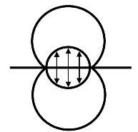
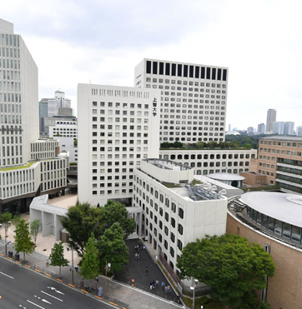
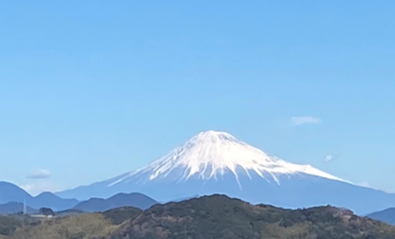
・Layout of slides including title slide is up to you
・We recommend a 16:9 aspect ratio
・All materials, including the logo on this slide, can be freely used.
13th International Conference on Contact Mechanics and Wear of Rail/Wheel Systems
(CM2025), Tokyo, Japan, September 22-26, 2025

